Slide 1
CMSC424: Database Design Module: Database Implementation
Instructor: Amol Deshpande
amol@cs.umd.edu

Slide 2
Database Implementation
Shifting into discussing the internals of a DBMS
How data stored? How queries/transactions executed?
Topics:
Storage: How is data stored? Important features of the storage devices (RAM, Disks, SSDs, etc)
File Organization: How are tuples mapped to blocks
Indexes: How to quickly find specific tuples of interest (e.g., all ‘friends’ of ‘user0’)
Query processing: How to execute different relational operations? How to combine them to execute an SQL query?
Query optimization: How to choose the best way to execute a query?

Slide 3
Query Processing/Storage
user query
results
Given an input user query, decide how to “execute” it
Specify sequence of pages to be brought in memory
Operate upon the tuples to produce results
Query Processing Engine
page requests
pointers
to pages
Bringing pages from disk to memory
Managing the limited memory
Buffer Management
block requests
data
Space Management on Persistent Storage (e.g., Disks)
Storage hierarchy
How are relations mapped to files?
How are tuples mapped to disk blocks?

Slide 4
CMSC424: Database Design Module: Database Implementation
Storage: Storage Hierarchy
Instructor: Amol Deshpande
amol@cs.umd.edu

Slide 5
Storage Hierarchy
Book Chapters
10.1 (and some other online resources)
Key topics:
Differences between storage media
Storage hierarchy
Caches

Slide 6
Storage Options
At various points, data stored in different storage hardware
Memory, Disks, SSDs, Tapes, Cache
Tradeoffs between speed and cost of access
CPU needs the data in memory and cache to operate on it
Volatile vs nonvolatile
Volatile: Loses contents when power switched off
Sequential vs random access
Sequential: read the data contiguously
select * from employee
Random: read the data from anywhere at any time
select * from employee where name like ‘__a__b’

Slide 7
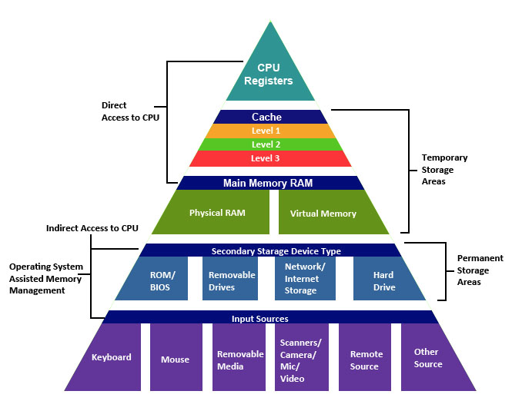
Storage Hierarchy
source: http://cse1.net/recaps/4-memory.html

Slide 8
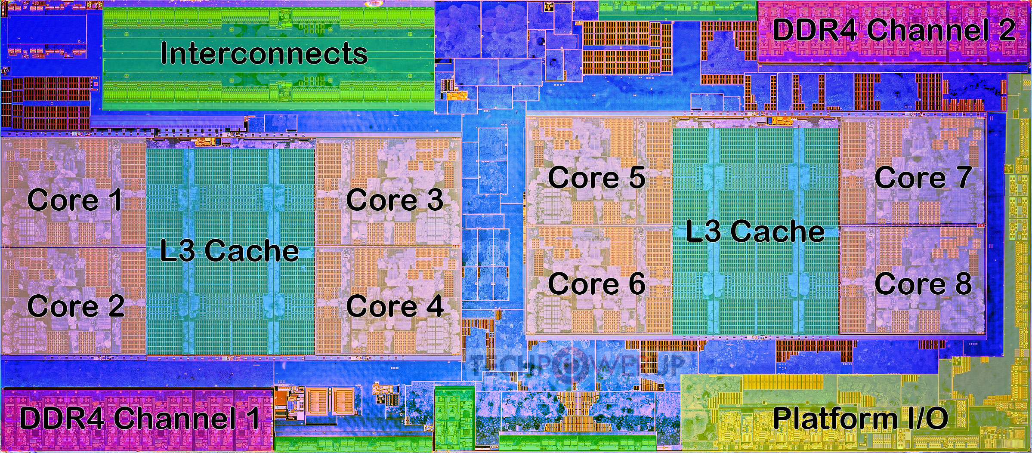
AMD Ryzen CPU Architecture
Die shot overlaid with functional units
https://www.techpowerup.com/review/amd-ryzen-5-1600/3.html

Slide 9
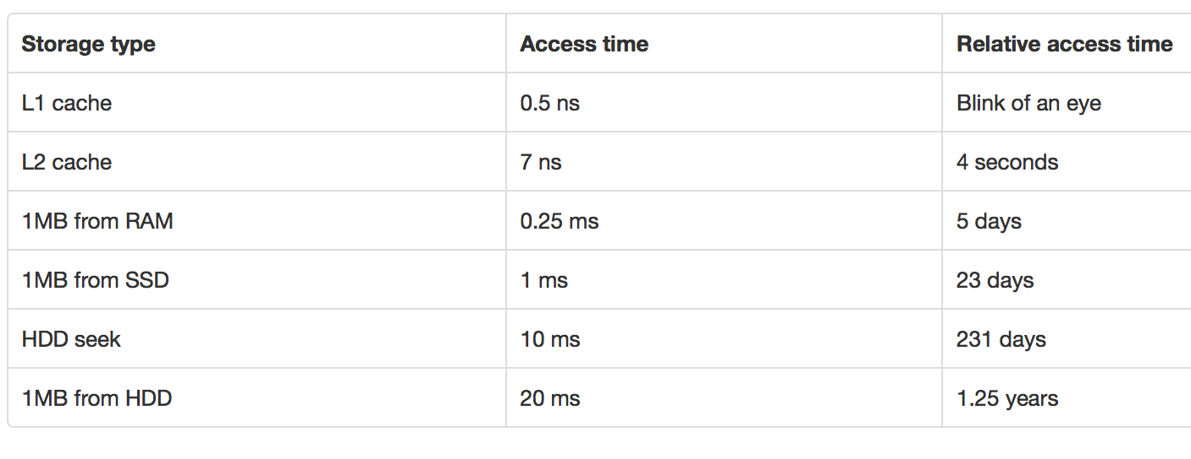
Storage Hierarchy
source: http://cse1.net/recaps/4-memory.html

Slide 10
Storage Options
Primary
e.g. Main memory, cache; typically volatile, fast
Secondary
e.g. Disks; Solid State Drives (SSD); non-volatile
Tertiary
e.g. Tapes; Non-volatile, super cheap, slow
Each storage media has different performance characteristics
Important to understand in order to write systems or optimize queries or tasks

Slide 11
Storage Hierarchy: Cache
Cache
Super fast; volatile; Typically on chip
L1 vs L2 vs L3 caches ???
L1 about 64KB or so; L2 about 1MB; L3 8MB (on chip) to 256MB (off chip)
Huge L3 caches available now-a-days
Becoming more and more important to care about this
Cache misses are expensive
Similar tradeoffs as were seen between main memory and disks

Slide 12
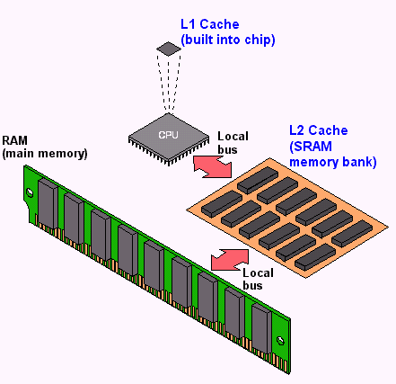
Storage Hierarchy: Cache
source: http://cse1.net/recaps/4-memory.html

Slide 13
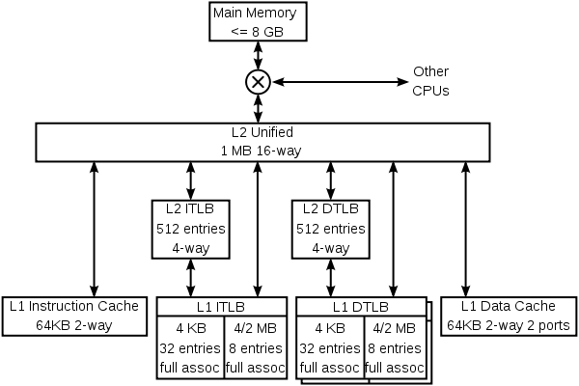
Storage Hierarchy: Cache
K8 core in the AMD Athlon 64 CPU

Slide 14
Storage Hierarchy: Main Memory
Data must be brought from disks/SSDs into Memory (and then into Caches) for the CPU to access it
CPU has no “direct” connection to the disks
10s or 100s of ns; Volatile (so will not survive a power failure)
Pretty cheap and dropping: 1GByte < $10 today
Main memory databases very common now-a-days
Dramatically changes the tradeoffs
Don’t need to worry about the disks or SSDs as much

Slide 15
Storage Hierarchy
Magnetic Disk (Hard Drive)
Non-volatile
Sequential access much much faster than random access
Discuss in more detail later
Optical Storage - CDs/DVDs; Jukeboxes
Used more as backups… Why ?
Very slow to write (if possible at all)
Tape storage
Backups; super-cheap; painful to access
IBM just released a secure tape drive storage solution

Slide 16
How important is this today?
Trade-offs shifted drastically over last 10-15 years
Especially with fast network, SSDs, and high memories
However, the volume of data is also growing quite rapidly
Some observations:
Cheaper to access another computer’s memory than accessing your own disk
Cache is playing more and more important role
Enough memory around that data often fits in memory of a single machine, or a cluster of machines
“Disk” considerations less important
Still: Disks are where most of the data lives today
Similar reasoning/algorithms required though

Slide 17
CMSC424: Database Design Module: Database Implementation
Storage: Disks and SSDs
Instructor: Amol Deshpande
amol@cs.umd.edu

Slide 18
Disks and SSDs
Book Chapters
10.2
Key topics:
Key components
Characteristics
Solid State Drives

Slide 19
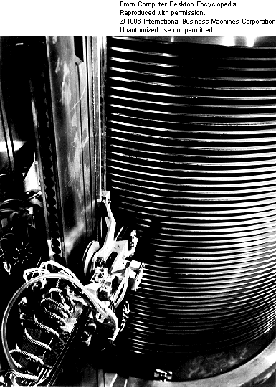
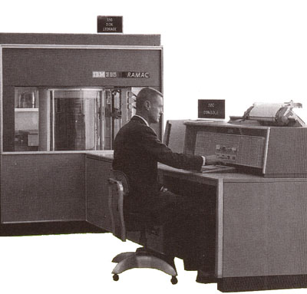
1956
IBM RAMAC
24” platters
100,000 characters each
5 million characters

Slide 20
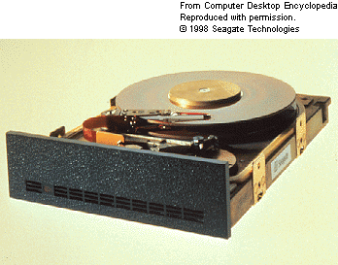
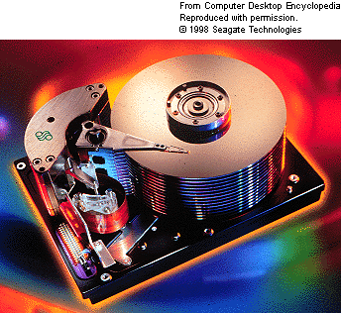

1979
SEAGATE
5MB
1998
SEAGATE
47GB
2006
Western Digital
500GB
Weight (max. g): 600g

Slide 22
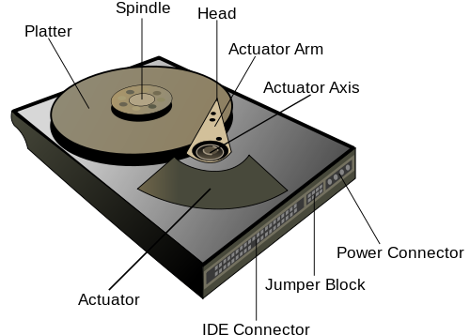

Slide 23

https://www.youtube.com/watch?v=9eMWG3fwiEU

Slide 24
“Typical” Values
Diameter: 1 inch → 15 inches
Cylinders: 100 → 2000
Surfaces: 1 or 2
(Tracks/cyl) 2 (floppies) → 30
Sector Size: 512B → 50K
Capacity → 360 KB to 2TB (as of Feb 2010)
Rotations per minute (rpm) → 5400 to 15000

Slide 25
Accessing Data
Accessing a sector
Time to seek to the track (seek time)
average 4 to 10ms
+ Waiting for the sector to get under the head (rotational latency)
average 4 to 11ms
+ Time to transfer the data (transfer time)
very low
About 10ms per access
So if randomly accessed blocks, can only do 100 block transfers
100 x 512bytes = 50 KB/s
Data transfer rates
Rate at which data can be transferred (w/o any seeks)
30-50MB/s to up to 200MB/s (Compare to above)
Seeks are bad !

Slide 26
Reliability
Mean time to/between failure (MTTF/MTBF):
57 to 136 years
Consider:
1000 new disks
1,200,000 hours of MTTF each
On average, one will fail 1200 hours = 50 days !
Need to assume disk failures are common
Handled today through keeping data in duplicate, or triplicate
If a disk fails, replace with a new disk and copy data over

Slide 27
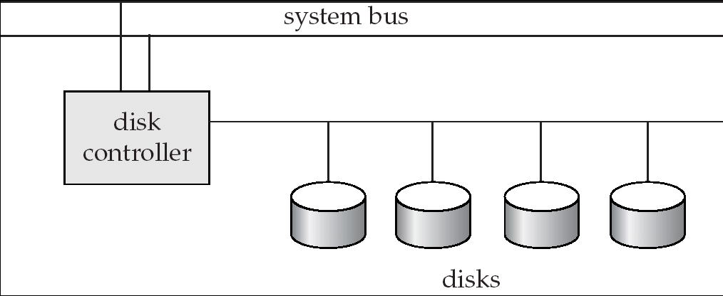
Disk Controller
Interface between the disk and the CPU
Accepts the commands
checksums to verify correctness
Remaps bad sectors

Slide 28
Optimizing block accesses
Typically sectors too small
Block: A contiguous sequence of sectors
512 bytes to several Kbytes
All data transfers done in units of blocks
Scheduling of block access requests ?
Considerations: performance and fairness
Elevator algorithm

Slide 29
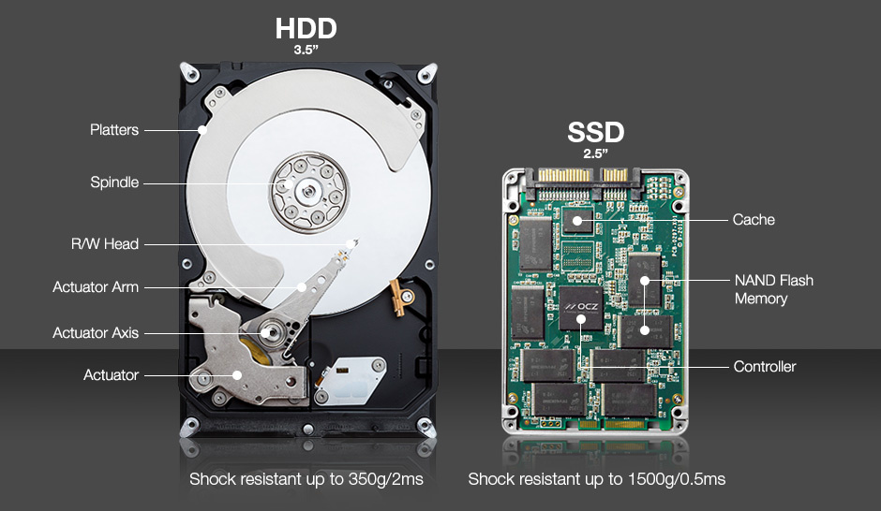
Solid State Drives
Essentially flash that emulates hard disk interfaces
https://blogs.umass.edu/Techbytes/2018/02/23/types-of-ssds-and-which-ones-to-buy/

Slide 30
Solid State Drives
Still support the same “block-oriented” interface
So reads/writes happen in units of blocks
No seeks → Much better random reads performance
Writes are more complicated
Must write an entire block at a time, after first “erasing” it
Limit on how many times you can erase a block
Wear leveling
Distributes writes across the SSD for uniform wearing out
Flash Translation Layer (FTL) takes care of these issues
About a factor of 5-10 more expensive right now

Slide 31
CMSC424: Database Design Module: Database Implementation
Virtual Memory and Buffer Manager
Instructor: Amol Deshpande
amol@umd.edu

Slide 32
Virtual memory and buffer manager
Book Chapters
10.7 and other resources (VM not covered in book)
Key topics:
Role of a Buffer Manager
Buffer Manager Replacement Policies
Key requirements and definitions for Buffer Manager
Brief recap of Virtual Memory and Why it matters in practice

Slide 33
Query Processing/Storage
user query
results
Given an input user query, decide how to “execute” it
Specify sequence of pages to be brought in memory
Operate upon the tuples to produce results
Query Processing Engine
page requests
pointers
to pages
Bringing pages from disk to memory
Managing the limited memory
Buffer Management
block requests
data
Space Management on Persistent Storage (e.g., Disks)
Storage hierarchy
How are relations mapped to files?
How are tuples mapped to disk blocks?

Slide 34
Buffer Manager
When the QP wants a block, it asks the “buffer manager”
The block must be in memory to operate upon
Buffer manager:
If block already in memory: return a pointer to it
If not:
Evict a current page
Either write it to temporary storage,
or write it back to its original location,
or just throw it away (if it was read from disk, and not modified)
and make a request to the storage subsystem to fetch it

Slide 35
Buffer Manager
Page Requests from Higher Levels
BUFFER POOL
disk page
free frame
MAIN MEMORY
DISK
choice of frame dictated
by replacement policy
DB

Slide 36
Buffer Manager
Similar to virtual memory manager
Buffer replacement policies
What page to evict ?
LRU: Least Recently Used
Throw out the page that was not used in a long time
MRU: Most Recently Used
The opposite
Why ? Works better for database “scan” operations
LRU-k
Look at the penultimate access rather than the last access
Does as well as MRU for scans

Slide 37
Replacement Policy: Example
Say Buffer can hold 3 pages, and pages are: A, B, C, D, E, F
For LRU-2: we look at the second-last access
If no second-last access, then treat it as: - ∞
Break ties based on last access
Once a page goes to disk, the accesses reset
Page Request | LRU State | MRU State | LRU-2 State
A | A | A | A
B | A, B | B, A | A, B
C | A, B, C | C, B, A | A, B, C
D | B, C, D | D, B, A | B, C, D
A | C, D, A | A, D, B | C, D, A
C | D, A, C | C, D, B | D, A, C
B | A, C, B | B, C, D | A, B, C
Order of eviction
i.e., A will be evicted first
Different from LRU – B will be evicted earlier
Penultimate access for C is earlier than B (- infinity for B)

Slide 38
Buffer Manager
Pinning a block
Not allowed to write back to the disk
Force-output (force-write)
Force the contents of a block to be written to disk
Order the writes
This block must be written to disk before this block
Critical for fault tolerant guarantees
Otherwise the database has no control over whats on disk and whats not on disk

Slide 39
Reality Check…
Most operating systems don’t provide user programs with direct access to memory
Some DBs built their own OSs because of this in the early days
Most databases today run on top of your OSes
Including our PostgreSQL
Causes several problems
OS Buffer Manager doesn’t provide the required functionality
No real control over when pages are written back
Can’t “pin” pages, or “force-write”

Slide 40
Reality Check…
Memory-mapped files help with many of these issues
Allow mapping a disk file directly to virtual memory
More efficient than going through the OS
With increasing memory sizes, most databases now-a-days fit in memory
Many newer database systems redesigned to exploit this
Issues of cache/memory, how memory is managed, etc. becoming increasingly important
Distributed/parallel architectures also add more complexity to this

Slide 41
CMSC424: Database Design Module: File Organization and Indexes
File Organization
Instructor: Amol Deshpande
amol@umd.edu

Slide 42
File Organization & Indexes Overview
Book Chapters
10.5, 10.6
Key topics:
Different ways the tuples mapped to disk blocks
Pros and cons of the different approaches

Slide 43
Review: Query Processing/Storage
user query
results
Given a input user query, decide how to “execute” it
Specify sequence of pages to be brought in memory
Operate upon the tuples to produce results
Query Processing Engine
page requests
pointers
to pages
Bringing pages from disk to memory
Managing the limited memory
Buffer Management
block requests
data
Space Management on Persistent Storage (e.g., Disks)
Storage hierarchy
How are relations mapped to files?
How are tuples mapped to disk blocks?

Slide 44
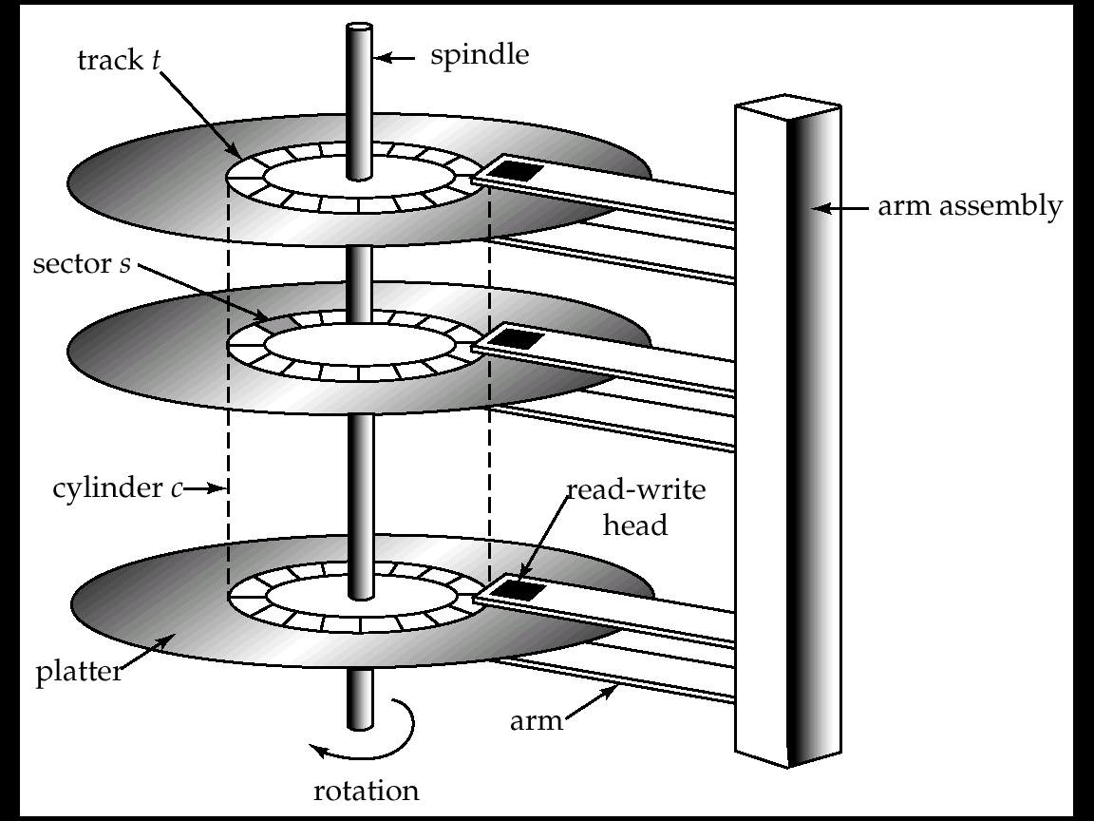
Mapping Tuples to Disk Blocks
Very important implications on performance
Quite a few different ways to do this
Similar issues even if not using disks as the primary storage
?

Slide 45
File Organization
Requirements and Performance Goals:
Allow insertion/deletions of tuples/records in relations
Fetch a particular record (specified by record id)
Find all tuples that match a condition (say SSN = 123) ?
Fetch all tuples from a specific relation (scans)
Faster if they are all sequential/in contiguous blocks
Allow building of “indexes”
Auxiliary data structures maintained on disks and in memory for faster retrieval
And so on…

Slide 46
File System or Not
Option 1: Use OS File System
File systems are a standard abstraction provided by Operating Systems (OS) for managing data
Major Con: Databases don’t have as much control over the physical placement anymore --- OS controls that
E.g., Say DBMS maps a relation to a “file”
No guarantee that the file will be “contiguous” on the disk
OS may spread it across the disk, and won’t even tell the DBMS
Option 2: DBMS directly works with the disk or uses a lightweight/custom OS
Increasingly uncommon – most DBMSs today run on top of OSes (e.g., PostgreSQL on your laptop, or on linux VMs in the cloud, or on a distributed HDFS)

Slide 47
Through a File System
Option 1: Allocate a single “file” on the disk, and treat it as a contiguous sequence of blocks
This is what PostgreSQL does
The blocks may not actually be contiguous on disk
Option 2: A different file per relation
Some of the simpler DBMS use this approach
Either way: we have a set of relations mapped to a set of blocks on disk

Slide 48
Assumptions for Now
Each relation stored separately on a separate set of blocks
Assumed to be contiguous
Each “index” maintained in a separate set of blocks
Assumed to be contiguous
Disk block
instructor
student
B+-tree index for instructor
Some extra space for new tuples

Slide 49
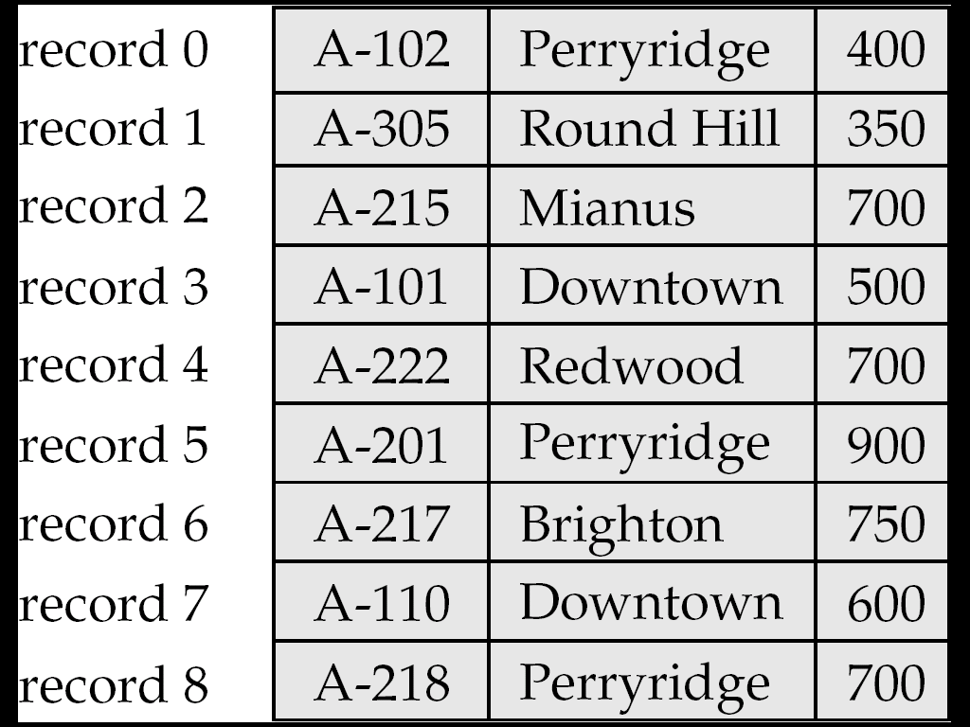
Within block: Fixed Length Records
n = number of bytes per record
Store record i at position:
n * (i – 1)
Records may cross blocks
Not desirable
Stagger so that that doesn’t happen
Inserting a tuple ?
Depends on the policy used
One option: Simply append at the end of the record
Deletions ?
Option 1: Rearrange
Option 2: Keep a free list and use for next insert

Slide 50
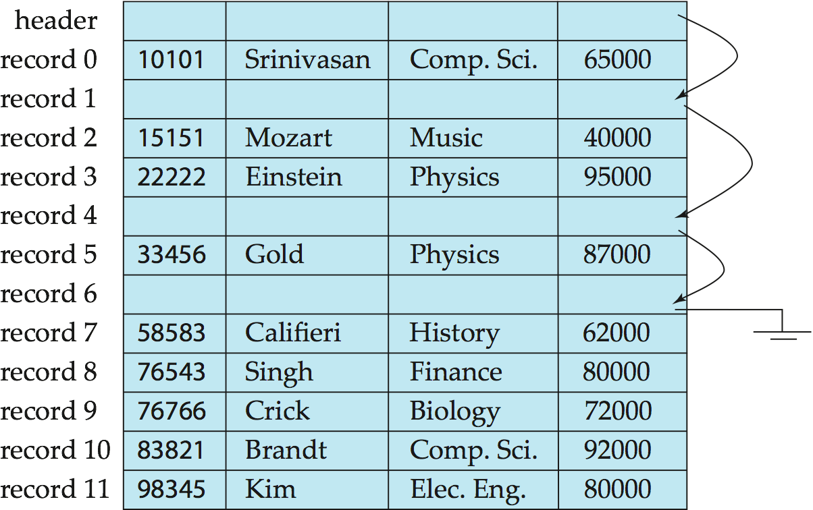
Within block: Fixed Length Records
Deleting: using “free lists”

Slide 51
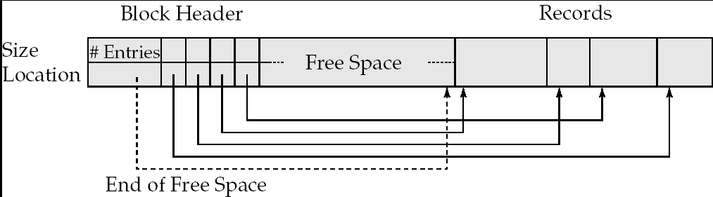
Within block: Variable-length Records
Slotted page/block structure
Indirection:
The records may move inside the page, but the outside world is oblivious to it
Why ?
The headers are used as a indirection mechanism
Record ID 1000 is the 5th entry in the page number X

Slide 52
Across Blocks of a Relation
Which block should a record go to ?
Anywhere ?
How to search for “SSN = 123” ?
Called “heap” organization
Sorted by SSN ?
Called “sequential” organization
Keeping it sorted would be painful
How would you search ?
Based on a “hash” key
Called “hashing” organization
Store the record with SSN = x in the block number x%1000
Why ?

Slide 53
Across Blocks: Sequential File Organization
Keep sorted by some search key
Insertion
Find the block in which the tuple should be
If there is free space, insert it
Otherwise, must create overflow pages
Deletions
Delete and keep the free space
Databases tend to be insert heavy, so free space gets used fast
Can become fragmented
Must reorganize once in a while

Slide 54
Across Blocks: Sequential File Organization
What if I want to find a particular record by value ?
Account info for SSN = 123
Binary search
Takes log(n) number of disk accesses
Random accesses
Too much
n = 1,000,000,000 -- log(n) = 30
Recall each random access approx 10 ms
300 ms to find just one account information
< 4 requests satisfied per second
Indexes – next topic

Slide 55
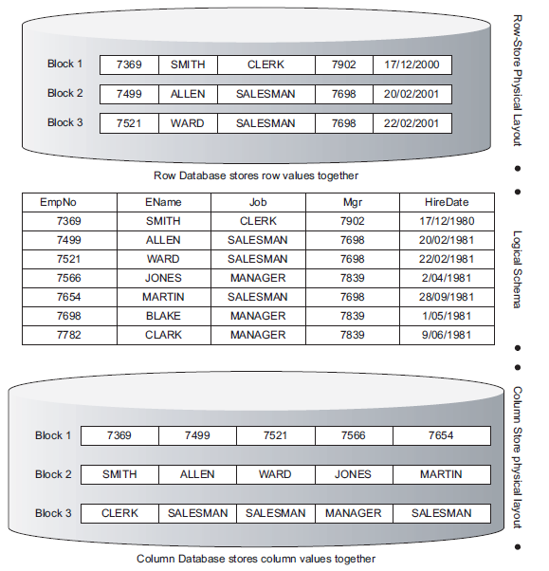
Advanced Topics
Row vs columnar representation:
We are largely focused on row representation
Column-based organization much more efficient for queries
But are not as efficient to update
Used by most modern warehouses

Slide 56
Advanced Topics
Data Storage Formats used in ”big data” world
Parquet, Avro, and many others
Sophisticated on-disk and in-memory representations for maintaining very large volumes of data as ”files”
That can be emailed, shared, interpreted by many different programs
Typically tend to be ”column-oriented”
Are not designed to be easy to update (by and large)
Lot of work in recent years on this

Slide 57
CMSC424: Database Design Module: File Organization and Indexes
Indexes Overview
Instructor: Amol Deshpande
amol@cs.umd.edu

Slide 58
File Organization & Indexes Overview
Book Chapters
11.1, 11.2
Key topics:
How an “index” helps efficiently find tuples that satisfy a condition?
What are key characteristics of indexes?

Slide 59
Index
A data structure for efficient search through large databaess
Two key ideas:
The records are mapped to the disk blocks in specific ways
Sorted, or hash-based
Auxiliary data structures are maintained that allow quick search
Search key:
Attribute or set of attributes used to look up records
E.g. SSN for a persons table
Two types of indexes
Ordered indexes
Hash-based indexes
Think library index/catalogue

Slide 60


Slide 61
Ordered Indexes
Primary index
The relation is sorted on the search key of the index
Secondary index
It is not
Can have only one primary index on a relation
^{Index}
^{Relation}

Slide 62
Primary Sparse Index
Every key doesn’t have to appear in the index
Allows for very small indexes
Better chance of fitting in memory
Tradeoff: Must access the relation file even if the record is not present

Slide 63
Primary Dense Index
Every key must appear in the index
Index becomes pretty large, but can often avoid having to go to the relation
E.g., select * from instructor where ID = 10000
Not found in the index, so can return immediately

Slide 64
Secondary Index
Relation sorted on ID
But we want an index on salary
Must be dense
Every search key must appear in the index

Slide 65
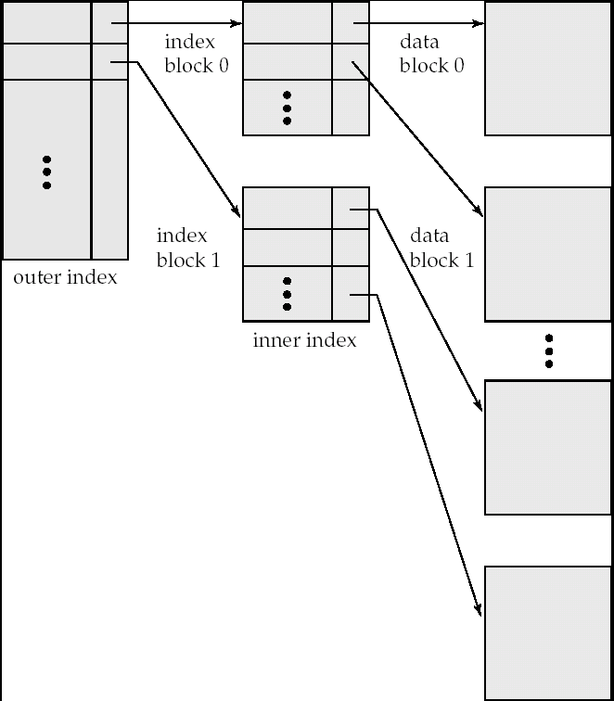
Multi-level Indexes
What if the index itself is too big for memory ?
Relation size = n = 1,000,000,000
Block size = 100 tuples per block
So, number of pages = 10,000,000
Keeping one entry per page takes too much space
Solution
Build an index on the index itself

Slide 66
Multi-level Indexes
How do you search through a multi-level index ?
What about keeping the index up-to-date ?
Tuple insertions and deletions
This is a static structure
Need overflow pages to deal with insertions
Works well if no inserts/deletes
Not so good when inserts and deletes are common

Slide 67
CMSC424: Database Design Module: File Organization and Indexes
B+-Trees: Basics
Instructor: Amol Deshpande
amol@cs.umd.edu

Slide 68
B+-Trees
Book Chapters
11.3
Key topics:
B+-Trees as a multi-level index, and basic properties
How to search in a B+-Tree?

Slide 69
Example B+-Tree Index
Index Disk Blocks

Slide 70
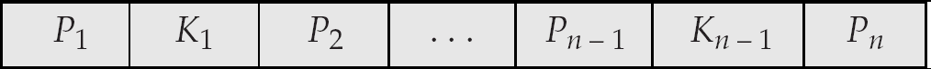
B⁺-Tree Node Structure
Typical node
K_{i} are the search-key values
P_{i} are pointers to children (for non-leaf nodes) or pointers to records or buckets of records (for leaf nodes).
The search-keys in a node are ordered
K₁ < K₂ < K₃ < . . . < K_{n–1}

Slide 71
Properties of B+-Trees
It is balanced
Every path from the root to a leaf is same length
Leaf nodes (at the bottom)
P1 contains the pointers to tuple(s) with key K1
…
Pn is a pointer to the next leaf node
Must contain at least n/2 entries

Slide 72
Properties
Interior nodes
All tuples in the subtree pointed to by P1, have search key < K1
To find a tuple with key K1’ < K1, follow P1
…
Finally, search keys in the tuples contained in the subtree pointed to by Pn, are all larger than Kn-1
Must contain at least n/2 entries (unless root)

Slide 73
B+-Trees - Searching
How to search ?
Follow the pointers
Logarithmic
log_{B/2}(N), where B = Number of entries per block
B is also called the order of the B+-Tree Index
Typically 100 or so
If a relation contains1,000,000,000 entries, takes only 4 random accesses
The top levels are typically in memory
So only requires 1 or 2 random accesses per request

Slide 74
Example B+-Tree Index

Slide 75
Example B+-Tree Index
If this were a “primary” index, then not all ”keys” are present in the index

Slide 76
B+ Trees in Practice
Typical order: 100. Typical fill-factor: 67%.
average fanout = 133
Typical capacities:
Height 3: 133³ = 2,352,637 entries
Height 4: 133⁴ = 312,900,700 entries
Can often hold top levels in buffer pool:
Level 1 = 1 page = 8 Kbytes
Level 2 = 133 pages = 1 Mbyte
Level 3 = 17,689 pages = 133 MBytes

Slide 77
CMSC424: Database Design Module: File Organization and Indexes
B+-Trees: Inserts
Instructor: Amol Deshpande
amol@cs.umd.edu

Slide 78
B+-Trees: Inserts
Book Chapters
11.3.3.1
Key topics:
How to insert a new entry in the index while keeping it balanced and satisfying half-full guarantees

Slide 79
Tuple Insertion
Find the leaf node where the search key should go
If already present
Insert record in the file. Update the bucket if necessary
This would be needed for secondary indexes
If not present
Insert the record in the file
Adjust the index
Add a new (Ki, Pi) pair to the leaf node
Recall the keys in the nodes are sorted
What if there is no space ?

Slide 80
B⁺-Trees: Insertion

Slide 81
Tuple Insertion
Splitting a node
Node has too many key-pointer pairs
Needs to store n, only has space for n-1
Split the node into two nodes
Put about half in each
Recursively go up the tree
May result in splitting all the way to the root
In fact, may end up adding a level to the tree
Pseudocode in the book !!

Slide 82
B⁺-Trees: Insertion

Slide 83
B⁺-Trees: Insertion

Slide 84
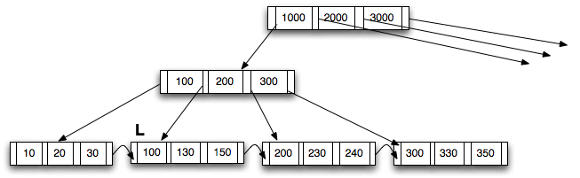
Another B+Tree Insertion Example
INITIAL TREE
Next slides show the insertion of (125) into this tree
According to the Algorithm in Figure 12.13, Page 495
Notes:
Parent of leaf containing Perryridge became underfull, and borrowed a pointer from its left sibling
Search-key value in the parent’s parent changes as a result

Slide 85
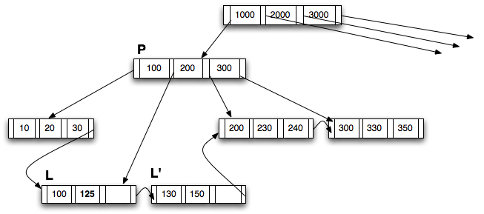
Another Example: INSERT (125)
Step 1: Split L to create L’
Insert the lowest value in L’ (130) upward into the parent P
Notes:
Parent of leaf containing Perryridge became underfull, and borrowed a pointer from its left sibling
Search-key value in the parent’s parent changes as a result

Slide 86
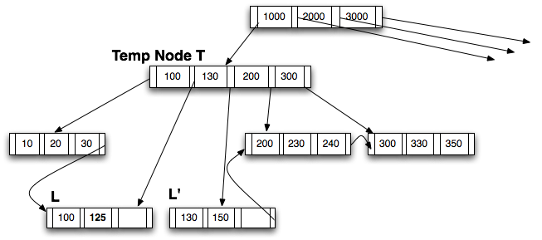
Another Example: INSERT (125)
Step 2: Insert (130) into P by creating a temp node T
Notes:
Parent of leaf containing Perryridge became underfull, and borrowed a pointer from its left sibling
Search-key value in the parent’s parent changes as a result

Slide 87
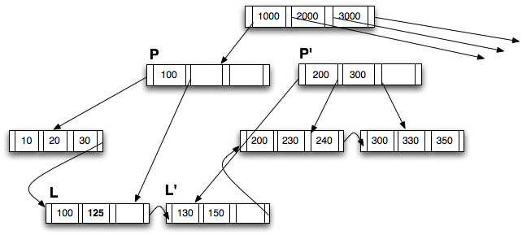
Another Example: INSERT (125)
Step 3: Create P’; distribute from T into P and P’
New P has only 1 key, but two pointers so it is OKAY.
This follows the last 4 lines of Figure 12.13 (note that “n” = 4)
K’’ = 130. Insert upward into the root
Notes:
Parent of leaf containing Perryridge became underfull, and borrowed a pointer from its left sibling
Search-key value in the parent’s parent changes as a result

Slide 88
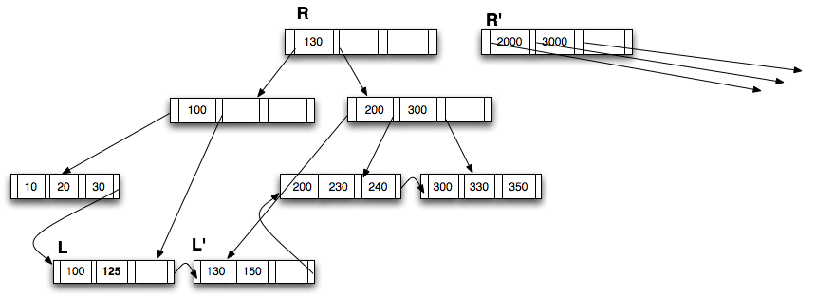
Another Example: INSERT (125)
Step 4: Insert (130) into the parent (R); create R’
Once again following the insert_in_parent() procedure, K’’ = 1000
Notes:
Parent of leaf containing Perryridge became underfull, and borrowed a pointer from its left sibling
Search-key value in the parent’s parent changes as a result

Slide 89
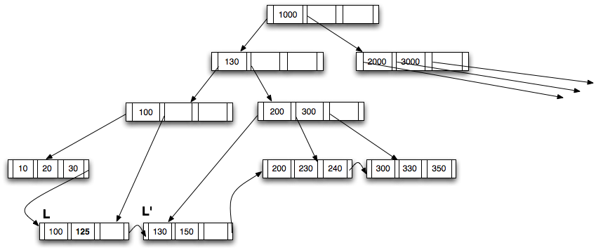
Another Example: INSERT (125)
Step 5: Create a new root
Notes:
Parent of leaf containing Perryridge became underfull, and borrowed a pointer from its left sibling
Search-key value in the parent’s parent changes as a result

Slide 90
CMSC424: Database Design Module: File Organization and Indexes
B+-Trees: Deletions
Instructor: Amol Deshpande
amol@cs.umd.edu

Slide 91
B+-Trees: Deletions
Book Chapters
11.3.3.2
Key topics:
How to delete an existing entry in the index while keeping it balanced and satisfying half-full guarantees

Slide 92
Updates on B⁺-Trees: Deletion
Find the record, delete it.
Remove the corresponding (search-key, pointer) pair from a leaf node
Note that there might be another tuple with the same search-key
In that case, this is not needed
Issue:
The leaf node now may contain too few entries
Why do we care ?
Solution:
See if you can borrow some entries from a sibling
If all the siblings are also just barely full, then merge (opposite of split)
May end up merging all the way to the root
In fact, may reduce the height of the tree by one

Slide 93
Examples of B⁺-Tree Deletion
Deleting “Katz” – No issues
Deleting “Gold” – Just delete from the leaf
Gold can stay in the “interior” node – no need to delete it
The purpose of the search keys in the interior nodes is to “direct” searches

Slide 94
Examples of B⁺-Tree Deletion
Deleting “Brandt”
The first leaf node becomes underful
Merge with the next node, and modify Parent appropriately.
Merged leaf node: Adams, Califieri, Crick
Updated parent node: Einstein, Gold (one fewer entry)

Slide 95
Examples of B⁺-Tree Deletion
Before and after deleting “Singh” and “Wu”

Slide 96
Examples of B⁺-Tree Deletion

Slide 97
Examples of B⁺-Tree Deletion
Deletion of “Gold”
Rightmost two leaves merged into a single one: (Katz, Kim, Mozart)
Need to remove a pointer from parent node (Kim), which also becomes underful and merged with its sibling (Califieri, Einstein) ➔ New root

Slide 98
CMSC424: Database Design Module: File Organization and Indexes
Hash Indexes
Instructor: Amol Deshpande
amol@cs.umd.edu

Slide 99
Hash Indexes
Book Chapters
11.6, 11.7 (at a high level)
Key topics:
Hash-based file organization
Static hashing-based indexes
Handling of bucket overflows
Extendable hashing and benefits
Comparing ordered and hashing indexes

Slide 100
Hash-based File Organization
Store record with search key k
in block number h(k)
e.g. for a person file,
h(SSN) = SSN % 4
Blocks called “buckets”
What if the block becomes full ?
Overflow pages
Uniformity property:
Don’t want all tuples to map to
the same bucket
h(SSN) = SSN % 2 would be bad
Hash functions should also be random
Should handle different real datasets
(1000, “A”,…)
(200, “B”,…)
(4044, “C”, …)
Block 0
(401, “Ax”,…)
(21, “Bx”,…)
Block 1
Buckets
(1002, “Ay”,…)
(10, “By”,…)
Block 2
(1003, “Az”,…)
(35, “Bz”,…)
Block 3

Slide 101
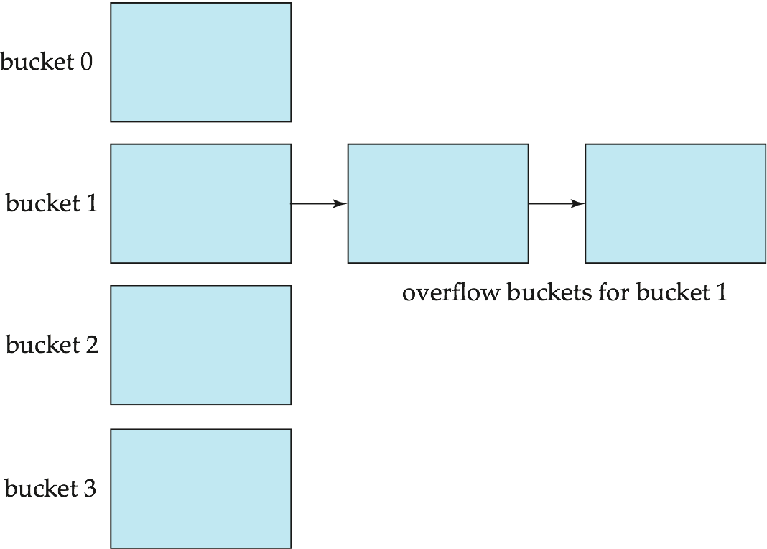
Overflow Pages
Overflow chaining – the overflow buckets of a given bucket are chained together in a linked list.
Above scheme is called closed hashing.
An alternative, called open hashing, which does not use overflow buckets, is not suitable for database applications.

Slide 102

Hash-based File Organization
Hashed on “branch-name”
Hash function:
a = 1, b = 2, .., z = 26
h(abz)
= (1 + 2 + 26) % 10
= 9

Slide 103
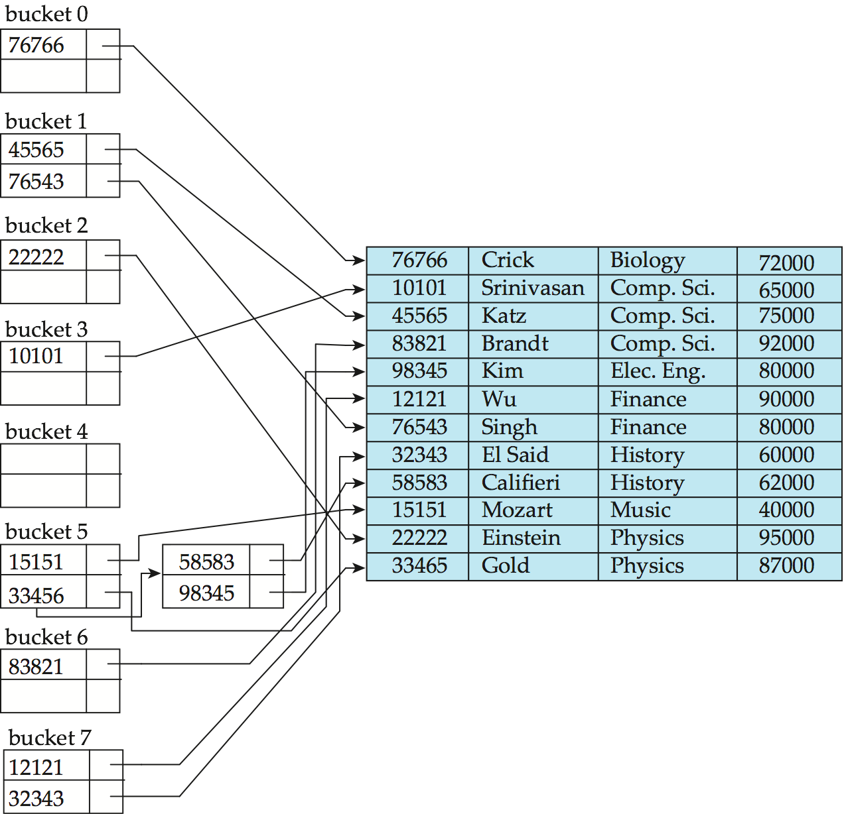
Hash Indexes
Extends the basic idea
Search:
Find the block with
search key
Follow the pointer
Range search ?
a < X < b ?
hash index on instructor, on attribute ID

Slide 104
Hash Indexes
Very fast search on equality
Can’t search for “ranges” at all
Must scan the file
Inserts/Deletes
Overflow pages can degrade the performance
Can do periodic reorganization (by modifying hash functions)
A better approach is to use “dynamic hashing”
Allow use of a hash function that can be modified
We discuss one such technique: Extendable Hashing

Slide 105
Extendable Hashing
Use a hash function that outputs a large number of bits, e.g., 32 bits or 64 bits
However, only use a “prefix” of that hash function based on the size of the database
Different parts of the database may use different length prefix
When “inserting”, if the bucket becomes too big, split it and use an extra bit

Slide 106
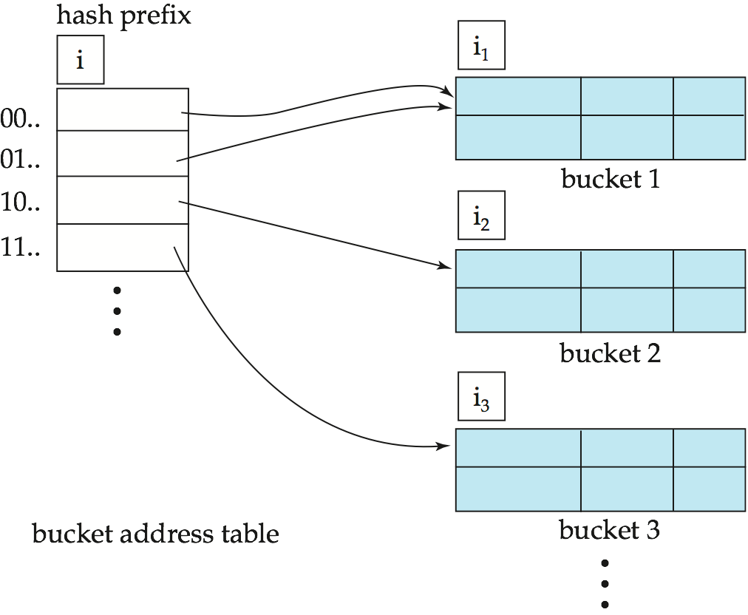
General Extendable Hash Structure

Slide 107
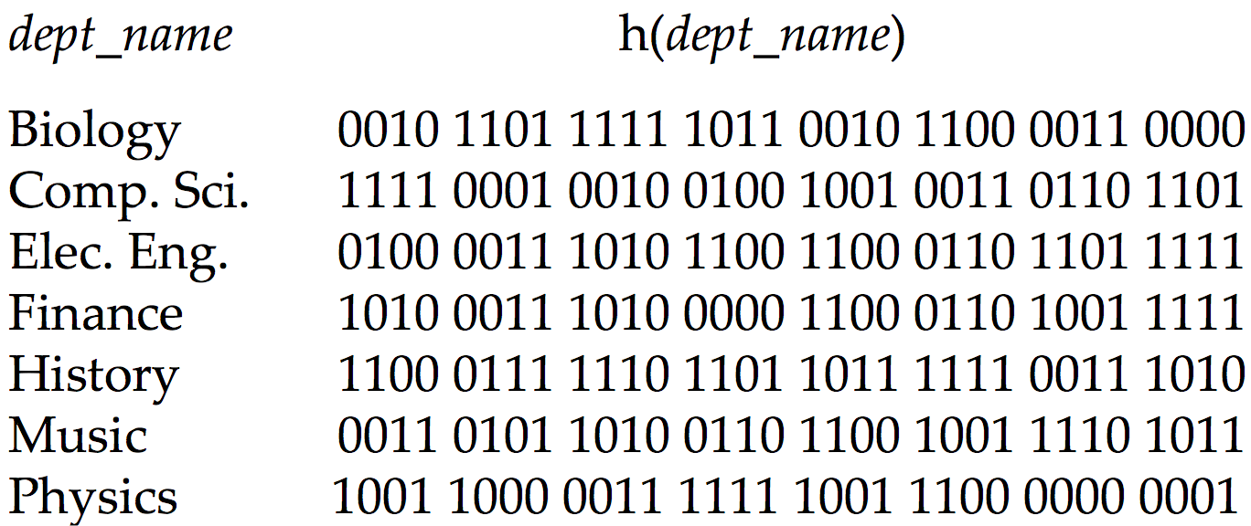
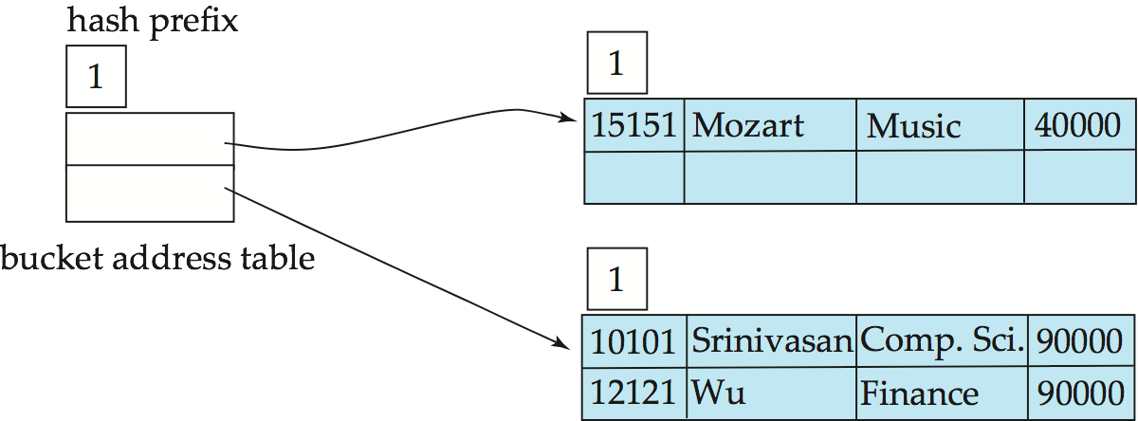
Example
Using only first bit so far

Slide 108
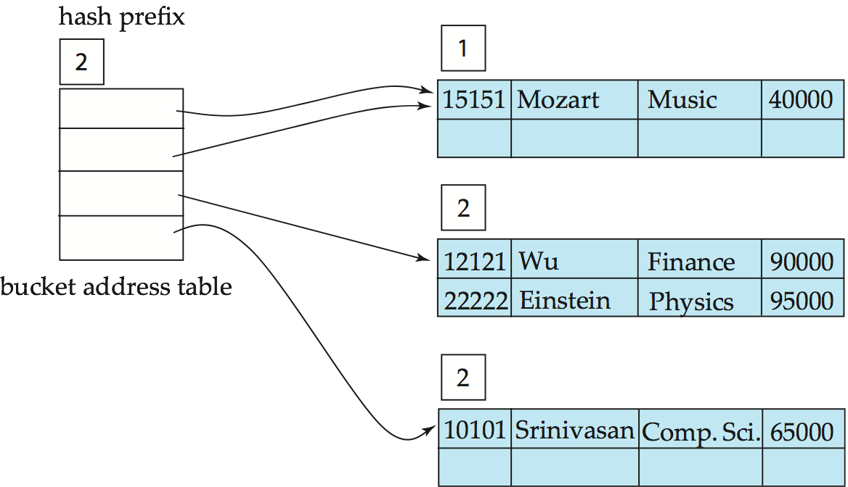
Example
Using first two bits now, but both 00 and 01 point to first bucket

Slide 109
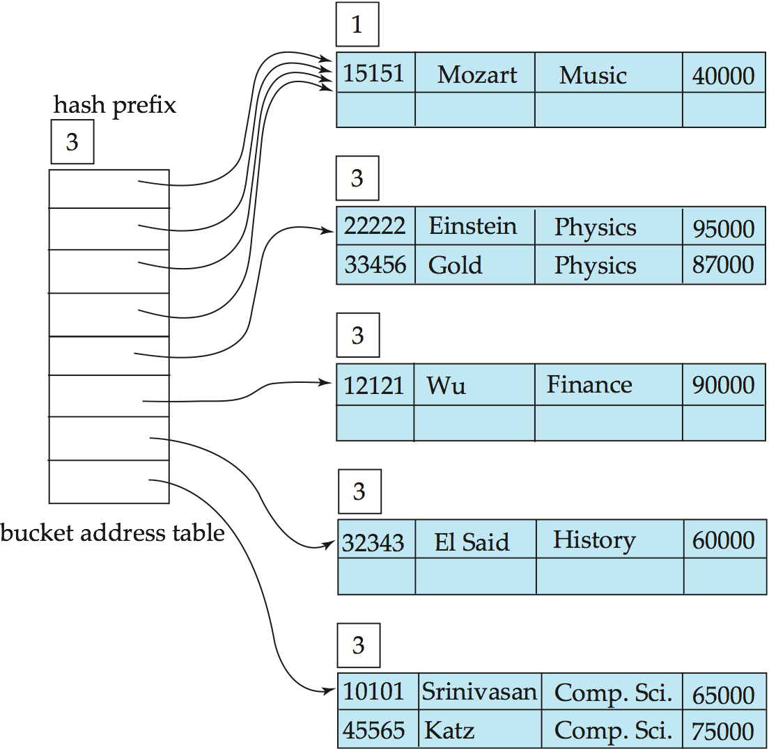
Example
Using first three bits now, but 0xx point to the first bucket

Slide 110
Extendable Hashing vs. Other Schemes
Benefits of extendable hashing:
Hash performance does not degrade with growth of file
Minimal space overhead
Disadvantages of extendable hashing
Extra level of indirection to find desired record
Bucket address table may itself become very big (larger than memory)
Changing size of bucket address table is an expensive operation
Linear hashing is an alternative mechanism
Allows incremental growth of its directory (equivalent to bucket address table)
At the cost of more bucket overflows

Slide 111
Comparison of Ordered Indexing and Hashing
Cost of periodic re-organization
Relative frequency of insertions and deletions
Is it desirable to optimize average access time at the expense of worst-case access time?
Expected type of queries:
Hashing is generally better at retrieving records having a specified value of the key.
If range queries are common, ordered indices are to be preferred
Hashing very common in distributed settings (e.g., in key-value stores)

Slide 112
CMSC424: Database Design Module: File Organization and Indexes
Indexes: Miscellaneous
Instructor: Amol Deshpande
amol@umd.edu

Slide 113
Indexes: Miscellaneous
Book Chapters
11.4.1, 11.4.5, 11.5, 11.9 (briefly)
Key topics:
B-Tree Indexes
B+-Tree File Organization
Multi-key indexes
Bitmap indexes
R-Trees

Slide 114
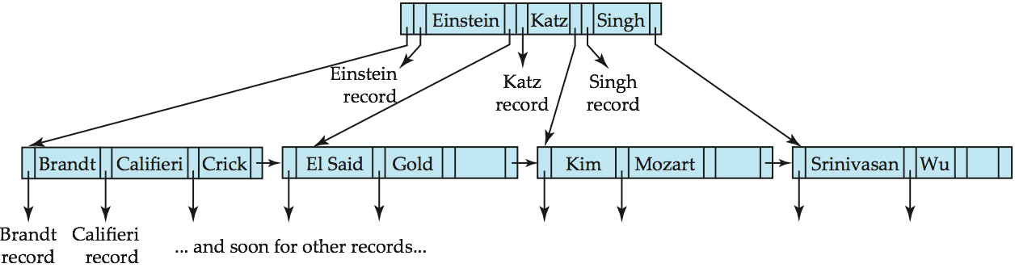
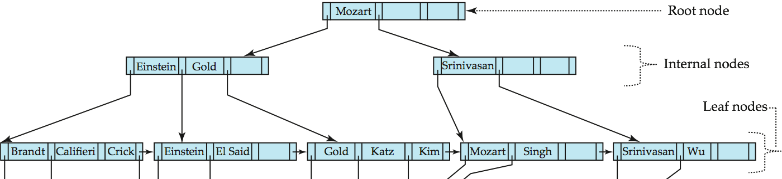
B-Tree Index Example
B-tree (above) and B+-tree (below) on same data – B-Trees have ”record pointers” at interior nodes

Slide 115
B-Tree Index Files (Cont.)
Advantages of B-Tree indices:
May use less tree nodes than a corresponding B⁺-Tree.
Sometimes possible to find search-key value before reaching leaf node.
Disadvantages of B-Tree indices:
Only small fraction of all search-key values are found early
Non-leaf nodes are larger, so fan-out is reduced. Thus, B-Trees typically have greater depth than corresponding B⁺-Tree
Insertion and deletion more complicated than in B⁺-Trees
Implementation is harder than B⁺-Trees.
Typically, advantages of B-Trees do not outweigh disadvantages.

Slide 116
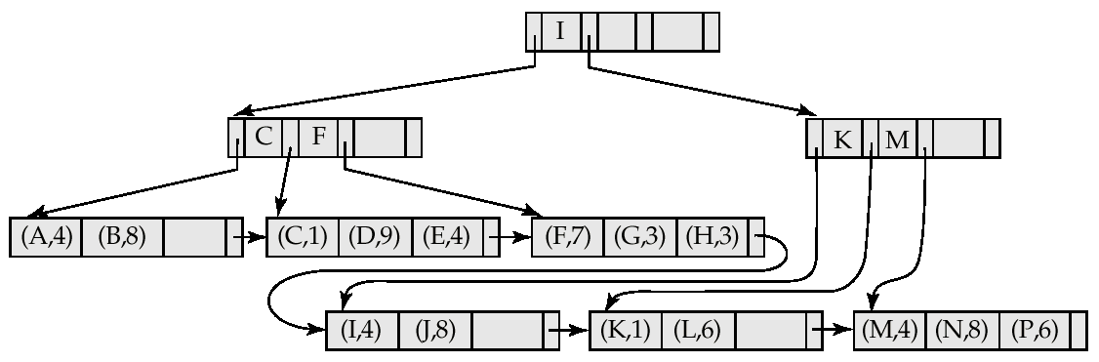
B+-Tree File Organization
Store the records at the leaves
Sorted order etc..

Slide 117
Multiple-Key Access
select ID
from instructor
where dept_name = “Finance” and salary = 80000
Possible strategies for processing query using indices on single attributes:
Use index on dept_name to find instructors with department name Finance; test salary = 80000
Use index on salary to find instructors with a salary of $80000; test dept_name = “Finance”.
Use dept_name index to find pointers to all records pertaining to the “Finance” department. Similarly use index on salary. Take intersection of both sets of pointers obtained.
Called “INDEX-ANDING”

Slide 118
Indices on Multiple Keys
Composite search keys are search keys containing more than one attribute
E.g. (dept_name, salary)
Lexicographic ordering: (a₁, a₂) < (b₁, b₂) if either
a₁ < b₁, or
a₁=b₁ and a₂ < b₂
Ideal for something like:
where dept_name = “Finance” and salary = 80000
Can also efficiently handle where dept_name = “Finance” and salary < 80000
But cannot efficiently handle where dept_name < “Finance” and balance = 80000

Slide 119
Bitmap Indices
Specialized indexes used in data warehouses
Assume records numbered sequentially from 0
Given a number n it must be easy to retrieve record n
Particularly easy if records are of fixed size
Best for attributes that with a small domain
E.g., gender, country, state, …
E.g., income-level (income broken up into a small number of levels such as 0-9999, 10000-19999, 20000-50000, 50000- infinity)
A bitmap is simply an array of bits

Slide 120
Bitmap Indices (Cont.)
Bitmap index on an attribute has one bitmap for each value of the attribute
Bitmap has as many bits as records
Keeps track of whether a record has that value for the attr

Slide 121
Bitmap Indices (Cont.)
Not particularly useful for single attribute queries
But consider a query: gender = m and income_level = L1
Retrieve individual bitmaps for those two
Do an AND to find all records that satisfy both conditions
Retrieve only those records
Can also be used for gender = m or income_level = L1
Really useful when queries have many predicates, and relations are large (i.e., a data warehouse)
Updating bitmap indexes is very expensive

Slide 122
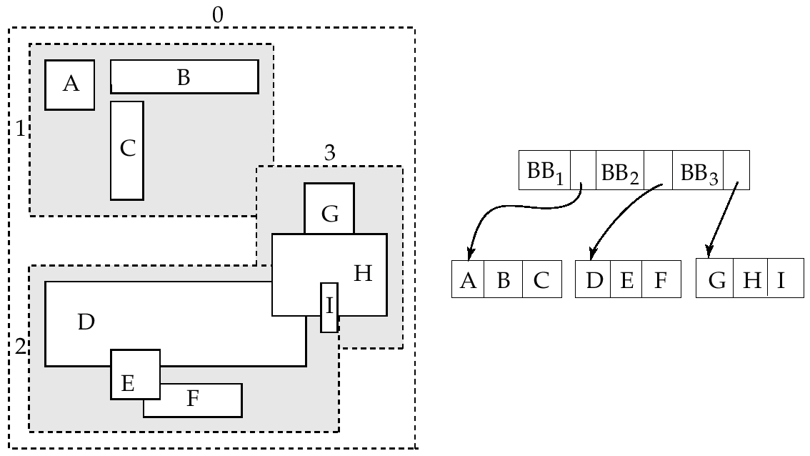
R-Trees
For spatial data (e.g. maps, rectangles, GPS data etc)

Slide 123
Conclusions
Indexing Goal: “Quickly find the tuples that match certain conditions”
Equality and range queries most common
Hence B+-Trees the predominant structure for on-disk representation
Hashing is used more commonly for in-memory operations
Many many more types of indexing structures exist
For different types of data
For different types of queries
E.g. “nearest-neighbor” queries

